Slide 1
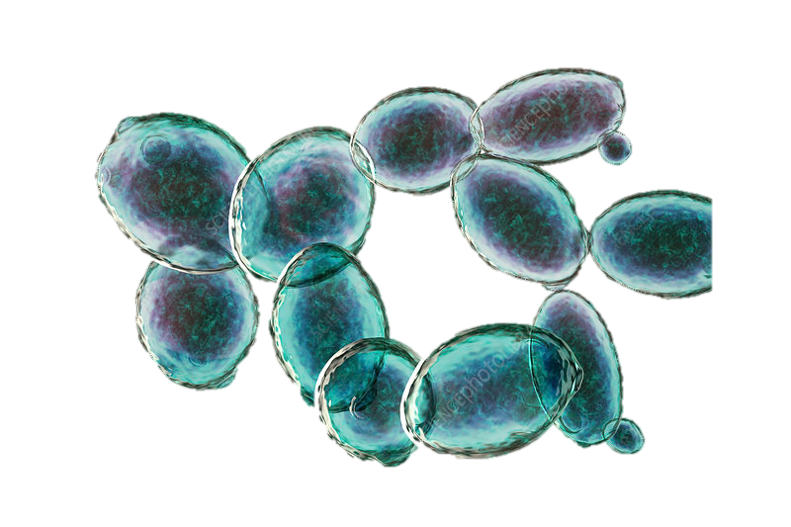
PROJECT 1
Data Analysis Applications in Agriculture Sciences
Presented by:
Joenilo II Esperas Paduhilao
April 26, 2024

Slide 2


INTRODUCTION
Yeast relies on nutrition for growth and survival
Natural Starvation may induce stress-resistance phenotype
Leucine starvation inhibits cell growth and yeasts die in exponential growth phase
ADE8 codes for phosphoribosylformylglycinamidine synthase
CEN.PK2-1D background (ade8 strain)
Synthetic Dextrose
Ade minus (-)
OBJECTIVES
Transcriptomic Analysis
To determine differentially expressed genes; and
To ascertain the pathways involved of the differentially expressed genes between the control and treated samples
Kokina et al. (2021)

Slide 3

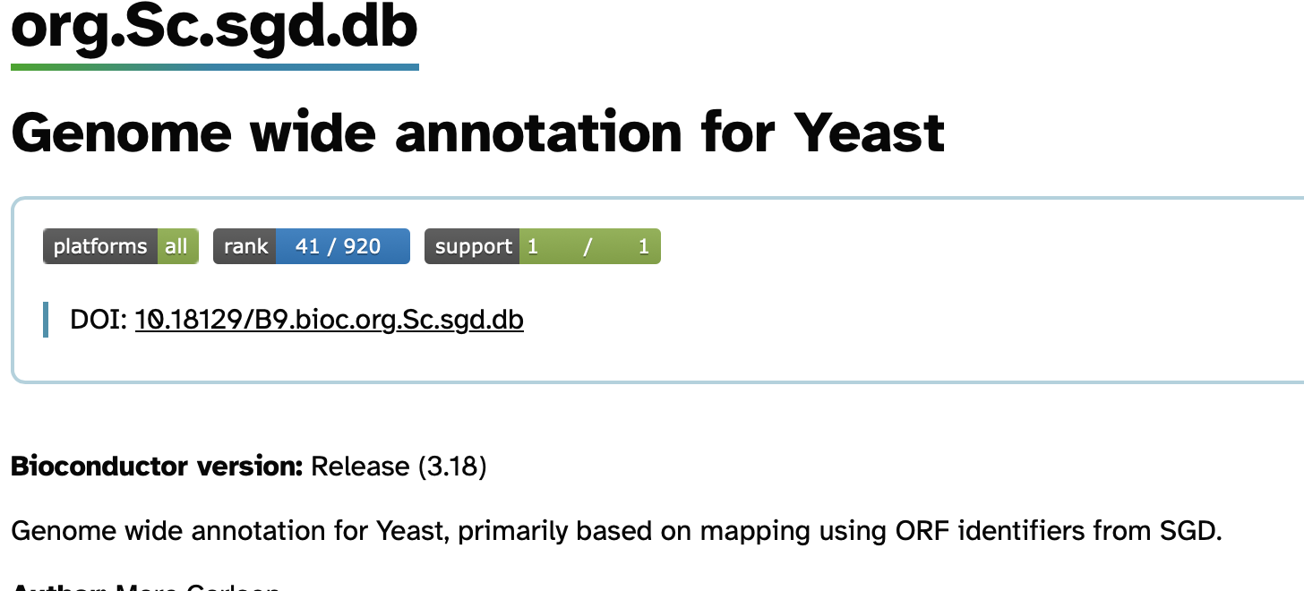
MATERIALS and METHODS
Table 1. Information of samples obtained from Kokina et al. (2021)
Fastqc
v0.11.8
Fastp
v0.23.4
DATASET
ERR4626657- ERR4626659 | Species: Saccharomyces cerevisae (brewer’s yeast) Alias: R5.0_S_r1-3 Platform: Illumina Model: Illumina MiSeq Center Name: University of Latvia Faculty of Medicine Layout: Single Library Selection: PCR
ERR4626660- ERR4626662 | Species: Saccharomyces cerevisae (brewer’s yeast) Sample_alias: R5.0_ade_minus_r1-3 Platform: Illumina Model: Illumina MiSeq Center Name: University of Latvia Faculty of Medicine Layout: Single Library Selection: PCR
Quality Assessment
Filtering
HISAT2 v2.2.1
Stringtie v2.2.1
Quantification
Ballgown v2.34.0
Statistical Analysis
Mapping to genome.fa and ann.gtf
IGV Visualization
R Visualization and Analysis
ClusterProfiler v4.10.1
GO Enrichment Analysis
KEGG Pathway Analysis

Slide 4
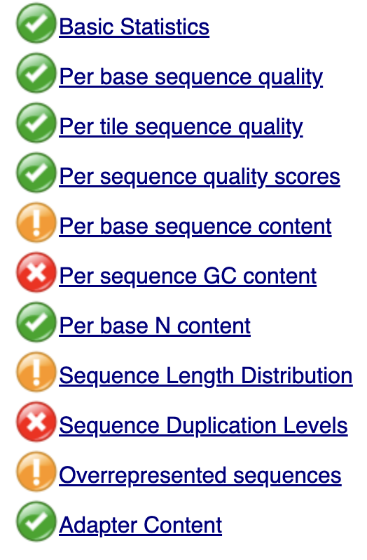
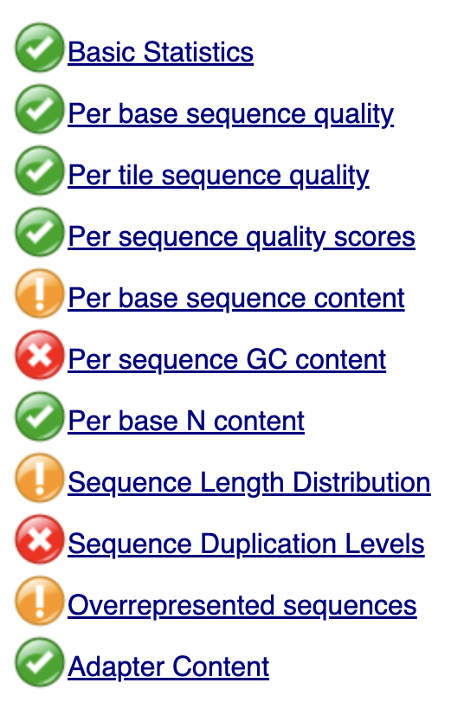
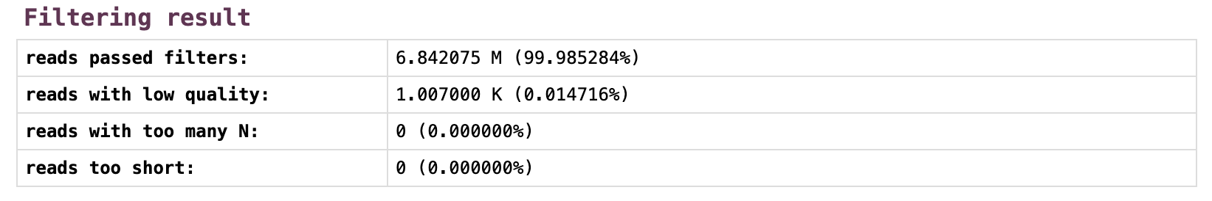
QUALITY
Before fastp
ERR4626657
After fastp

Slide 5
RESULTS
Table 2. Alignment Rate of the Dataset to Genome with HISAT2
DATA | Number of Reads | Aligned 0 times | Aligned exactly 1 time | Aligned >1 times | Overall Alignment Rate
ERR4626657 | 6842075 | 12.55% | 65.68% | 21.77% | 87.45%
ERR4626658 | 6067167 | 11.71% | 67.75% | 20.54% | 88.29%
ERR4626659 | 5590366 | 16.42% | 61.37% | 22.21% | 83.58%
ERR4626660 | 7381403 | 14.25% | 51.42% | 34.33% | 85.75%
ERR4626661 | 5879633 | 18.93% | 49.99% | 21.08% | 81.07%
ERR4626662 | 6555775 | 14.68% | 57.41% | 27.92% | 85.32%

Slide 6
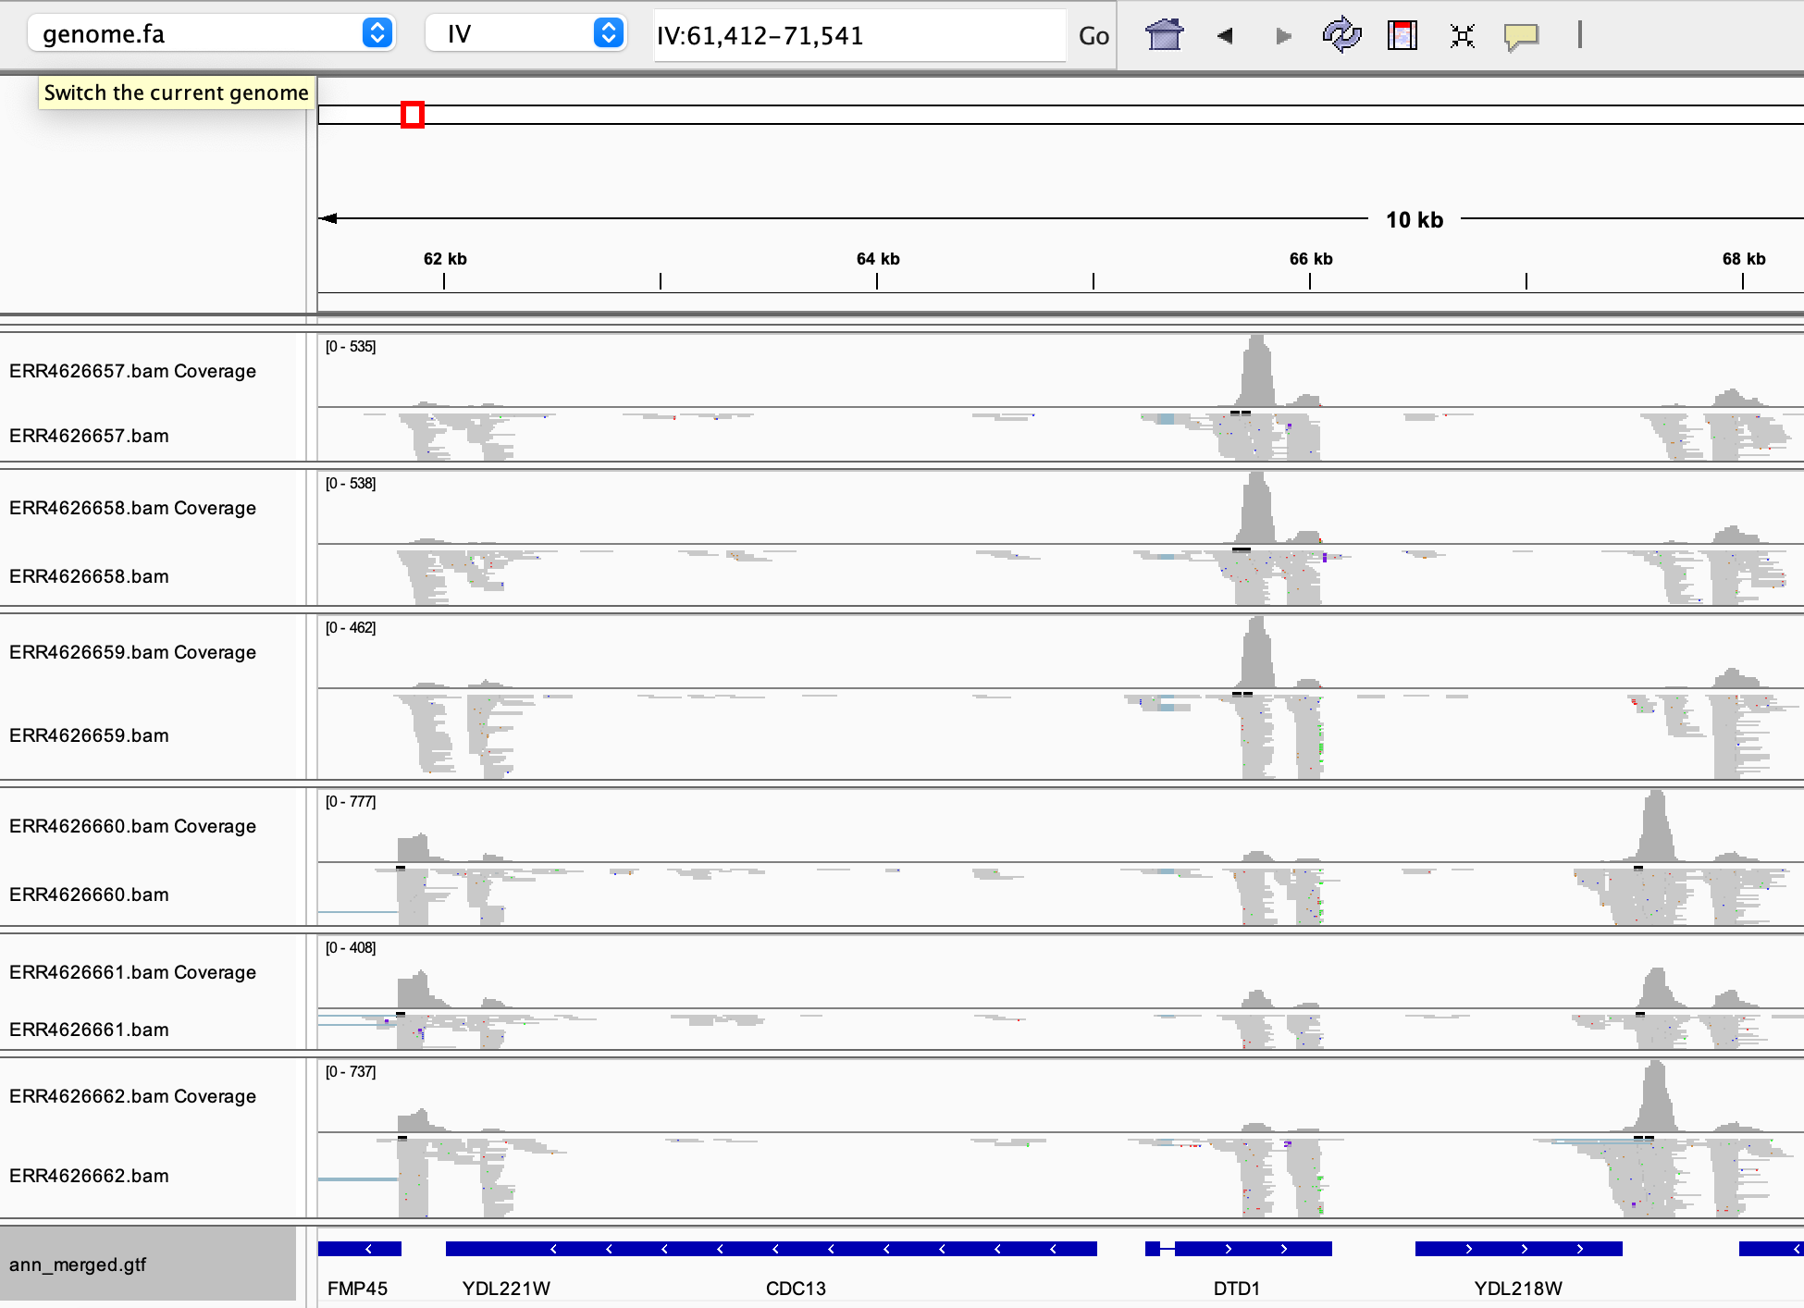
RESULTS

Slide 7
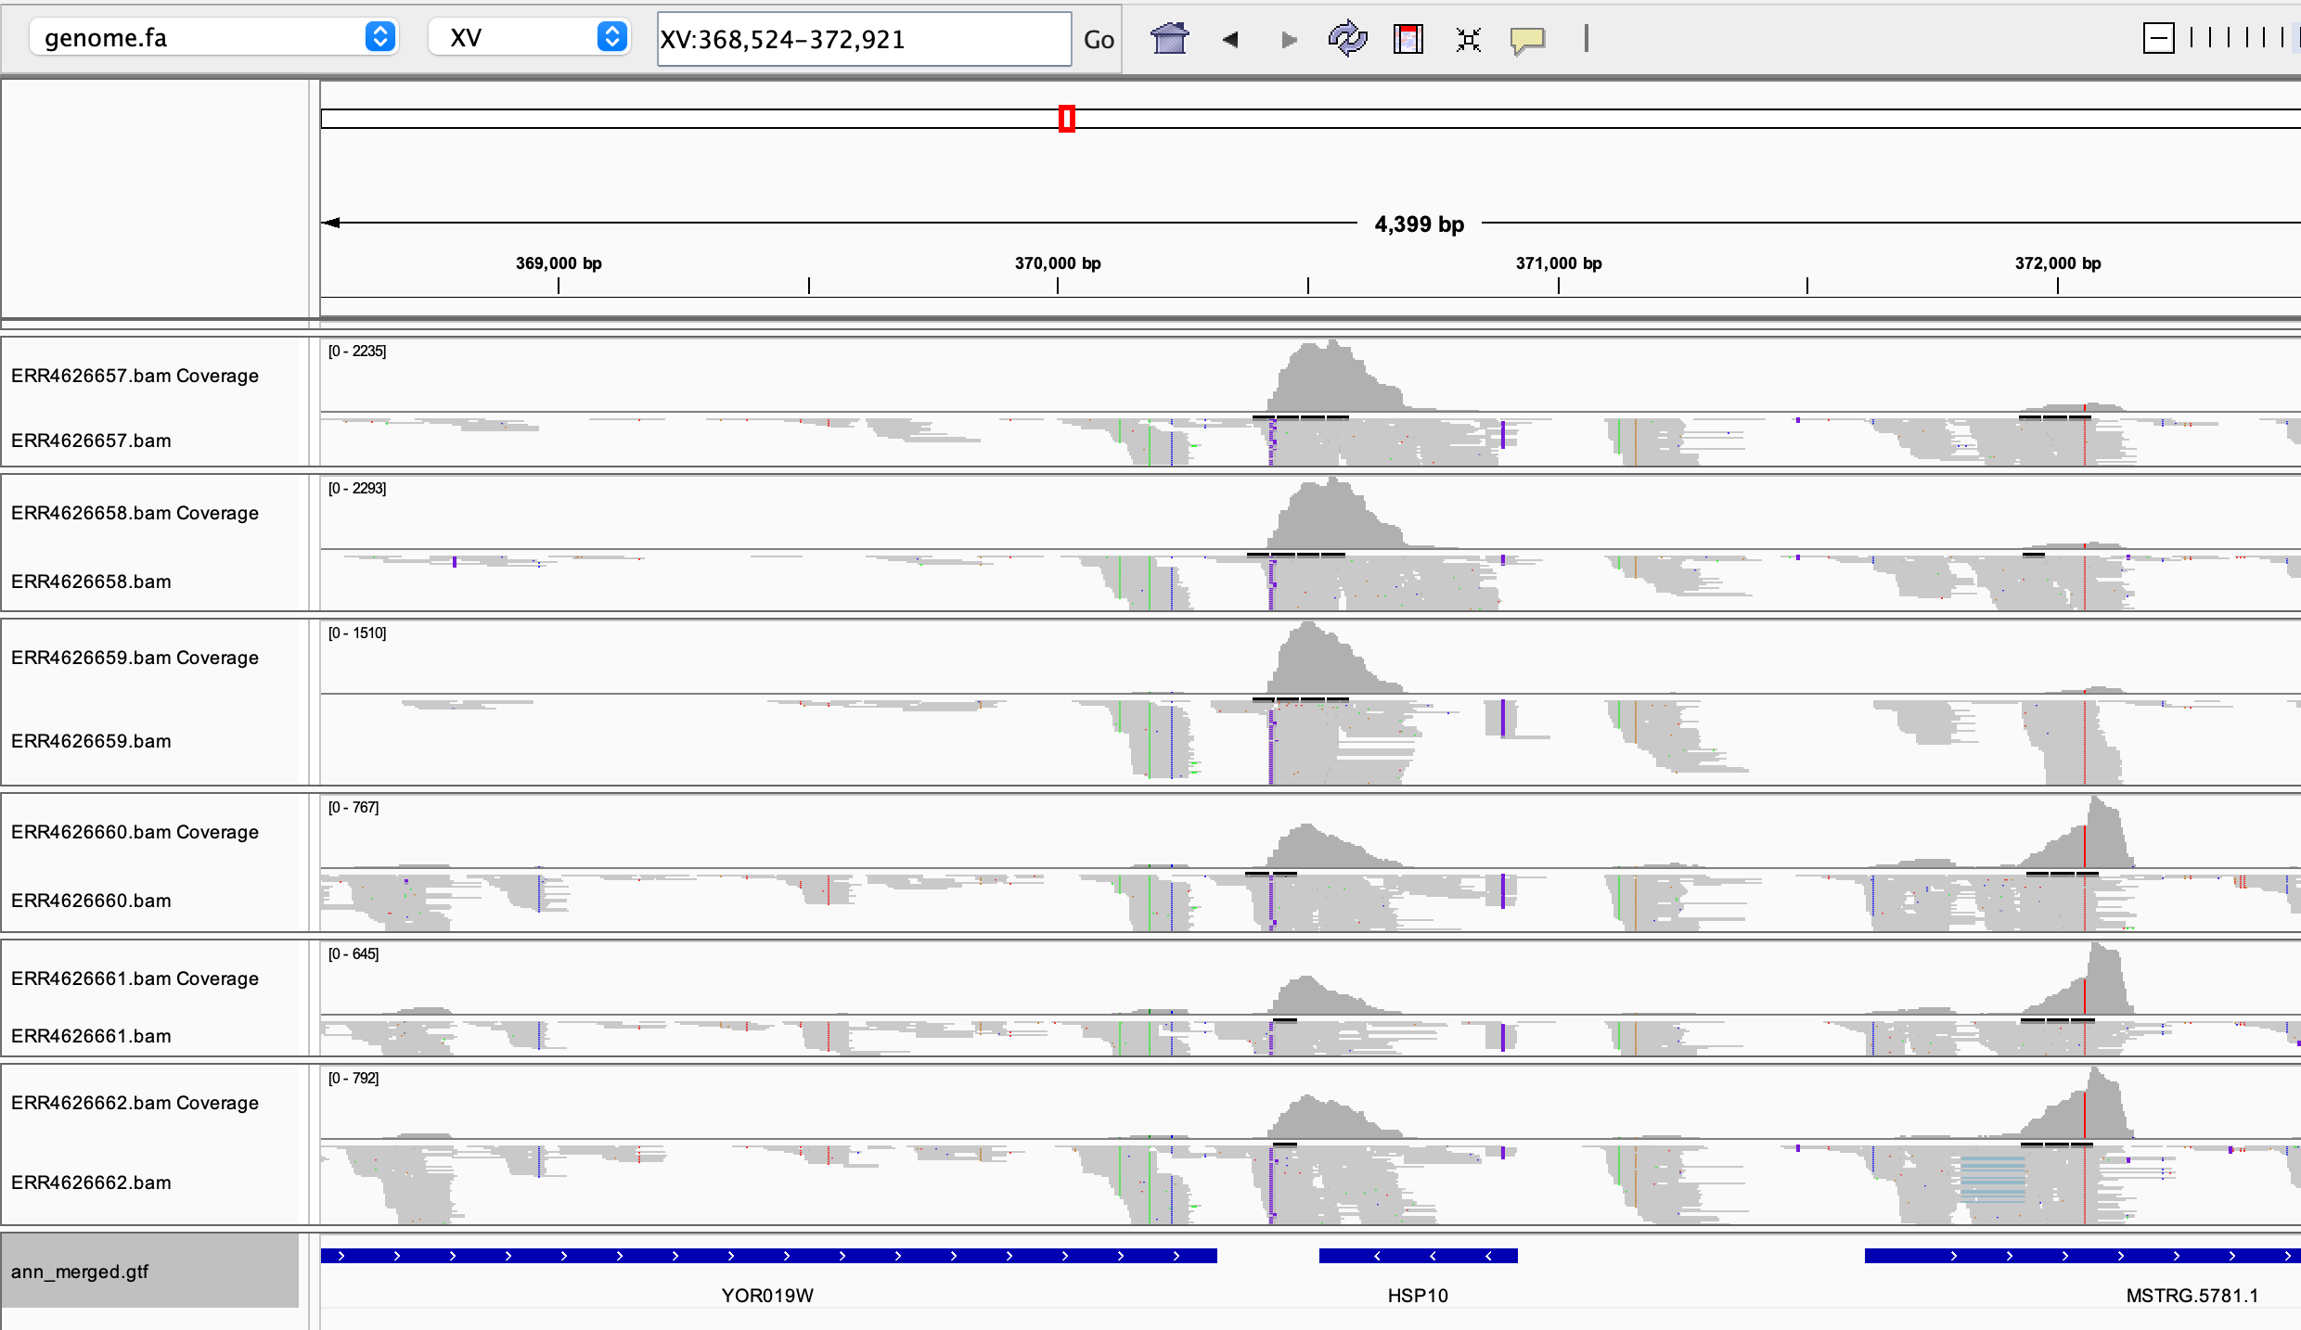
RESULTS

Slide 8
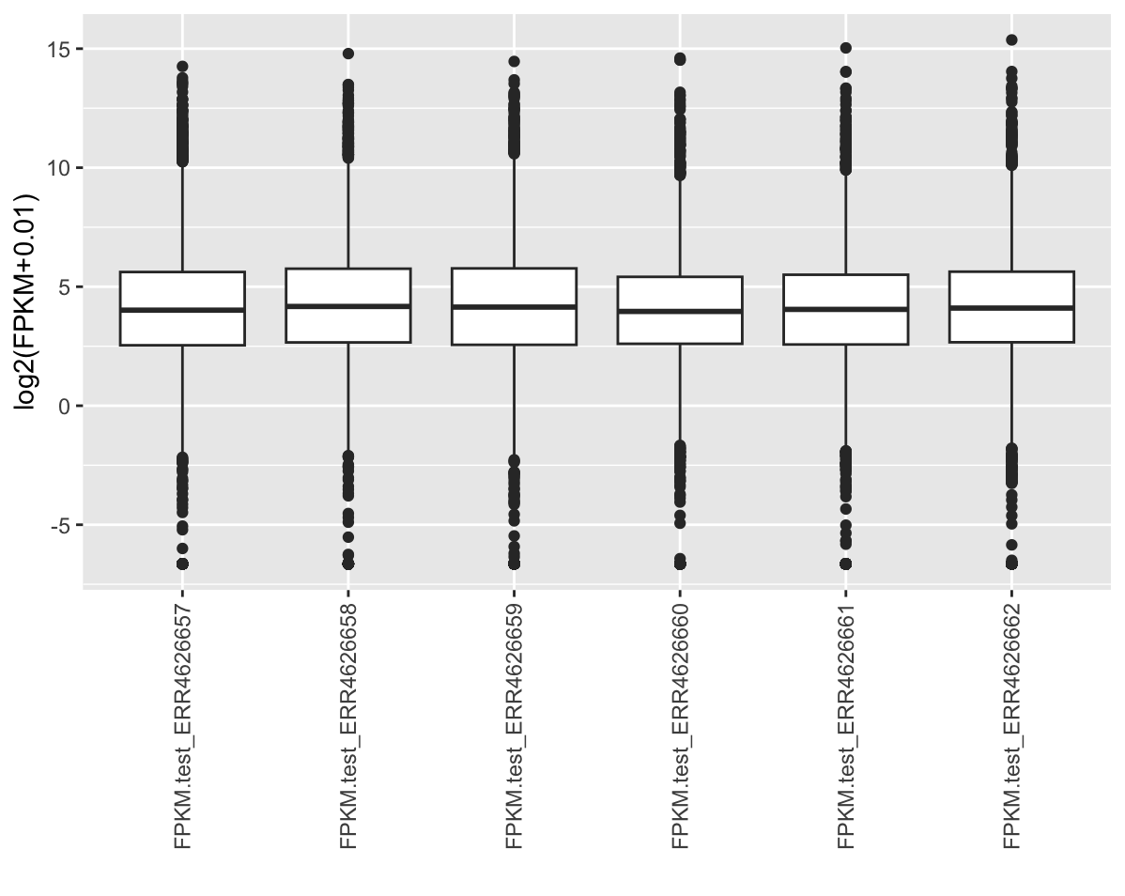
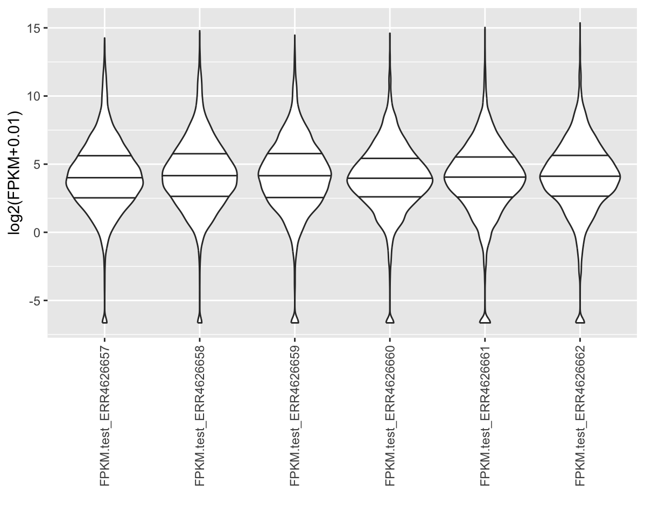
RESULTS
Figure 1. (a) Boxplot and (b) violin plot of transcripts with >1 mean expression level in FPKM.

Slide 9
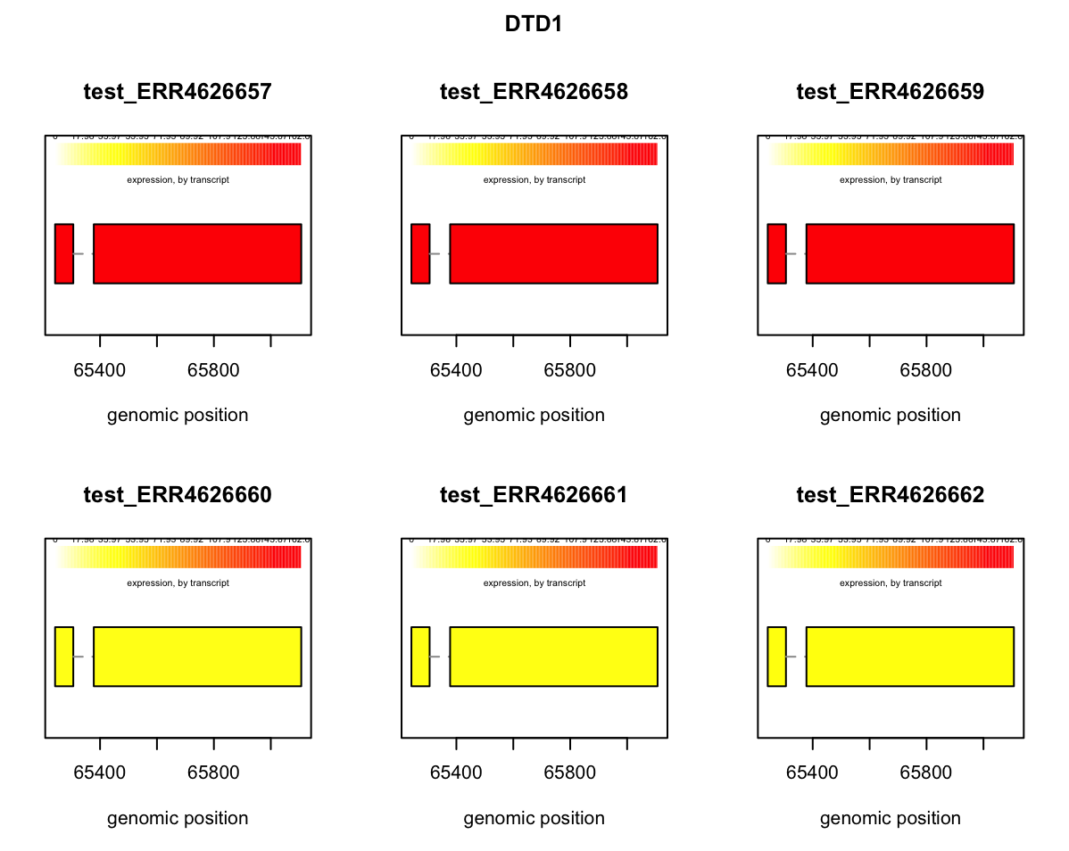
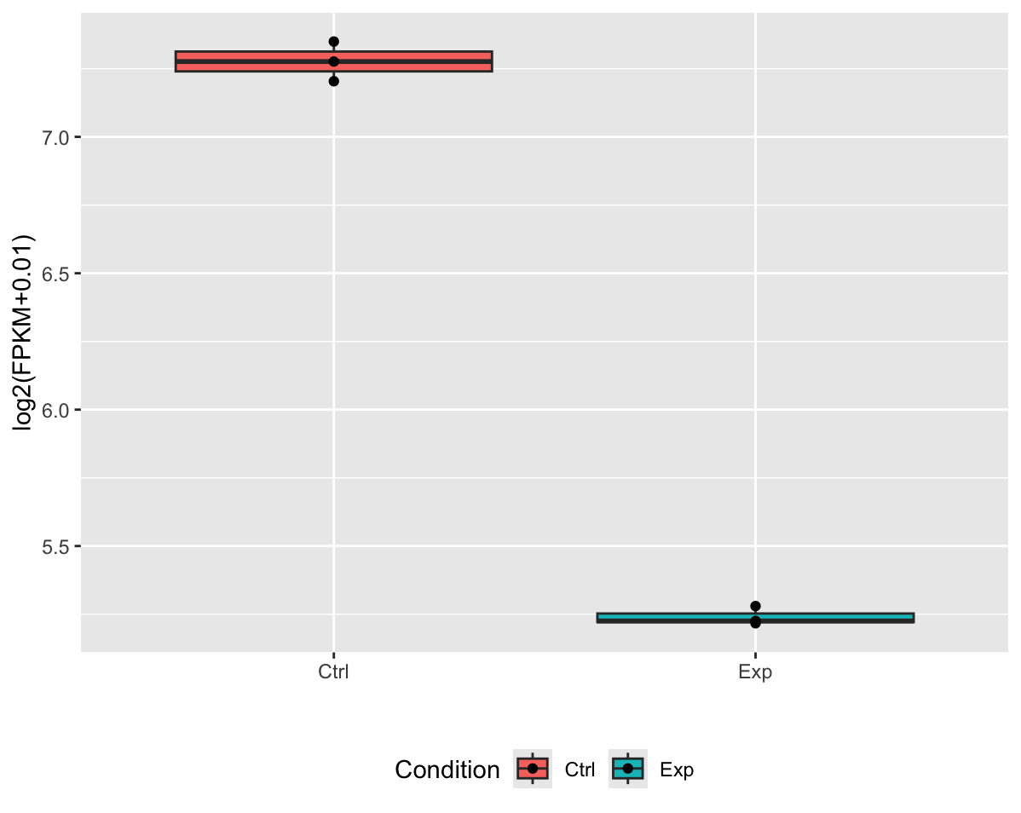
RESULTS
b
a
Figure 2. (a) Boxplot and (b) differential expression level of DTD1 between control and experimental dataset

Slide 10
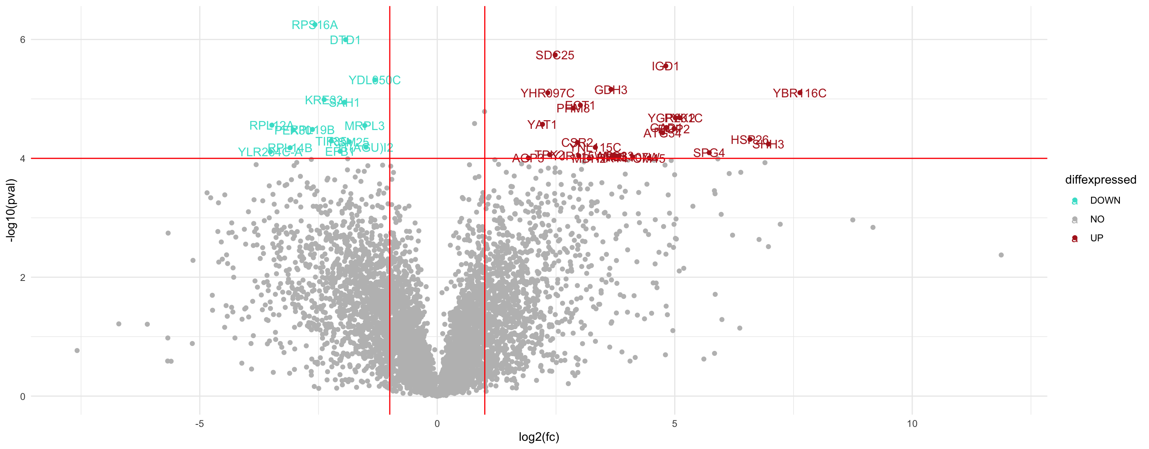
RESULTS
Figure 3 Volcano plot of upregulated and downregulated genes (pvalue < 0.0001)

Slide 11
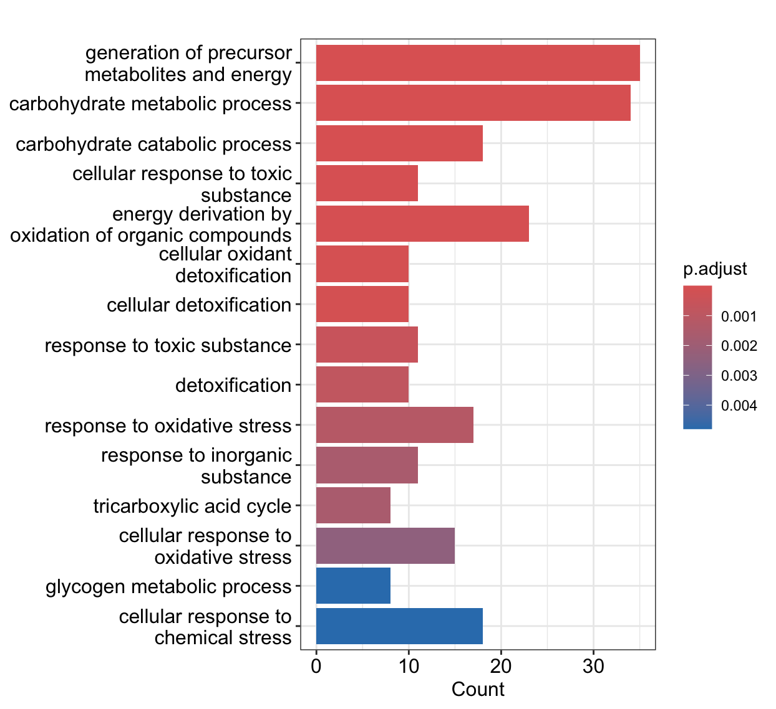
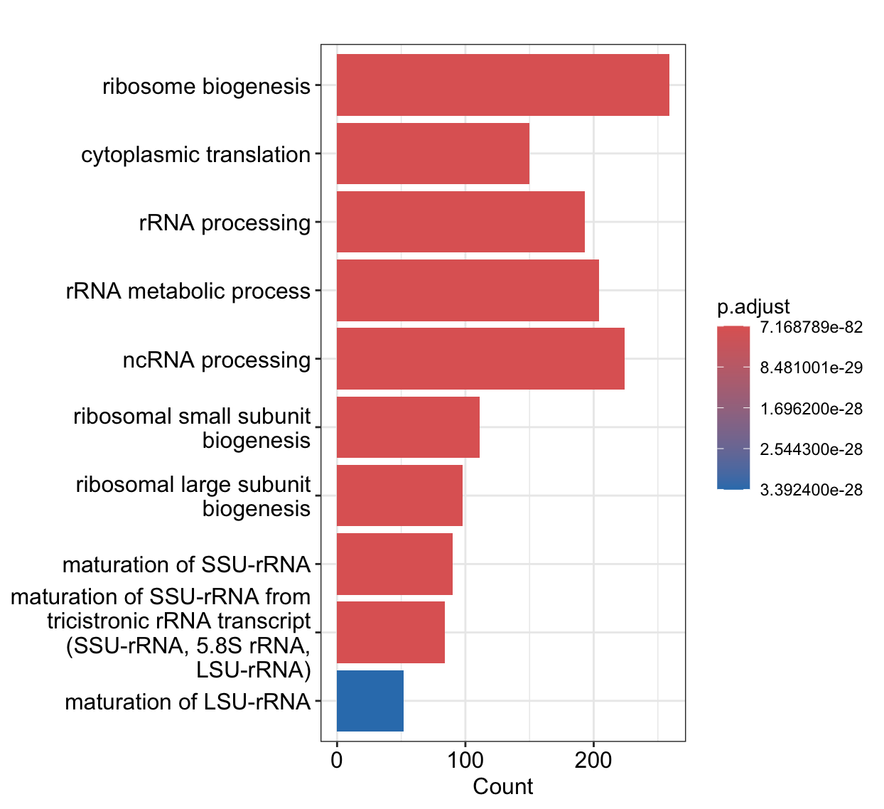
RESULTS
a
b
Figure 4 GO enrichment (Biological Process) of (a) upregulated and (b) downregulated genes based on -1 > log2(foldchange) > 1

Slide 12
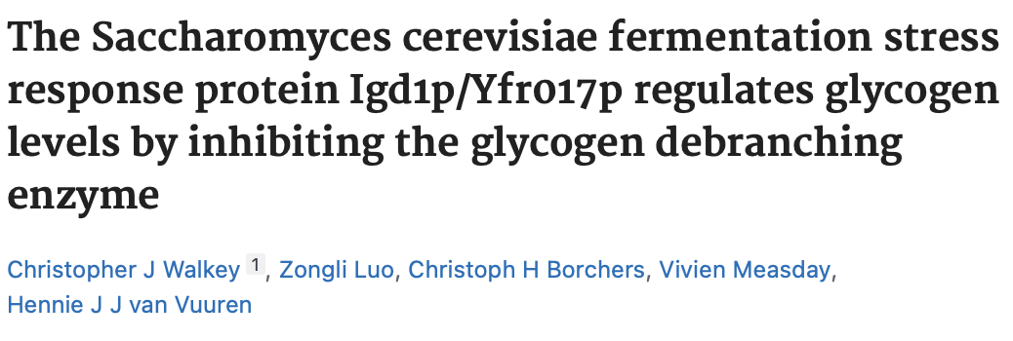
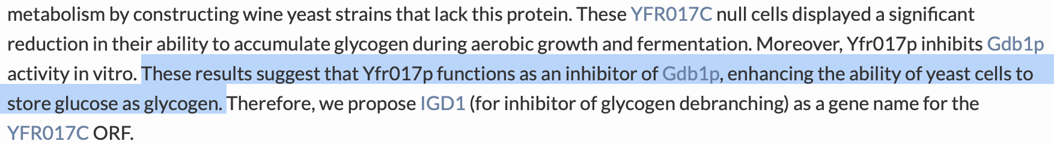
ENERGY SOURCE REGULATION
GO:0006091 generation of precursor metabolites and energy IGD1/PYK2/SHH3/NDE2/MLS1/MDH2/ETR1/PIG2/GLC3/GND2/SOL4/…

Slide 13
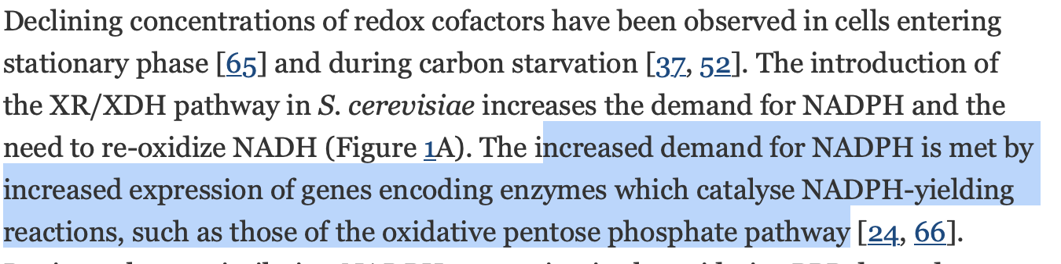
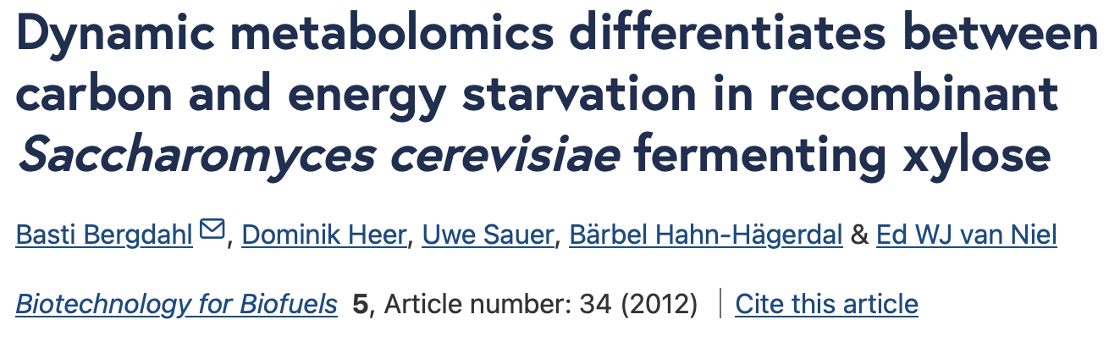
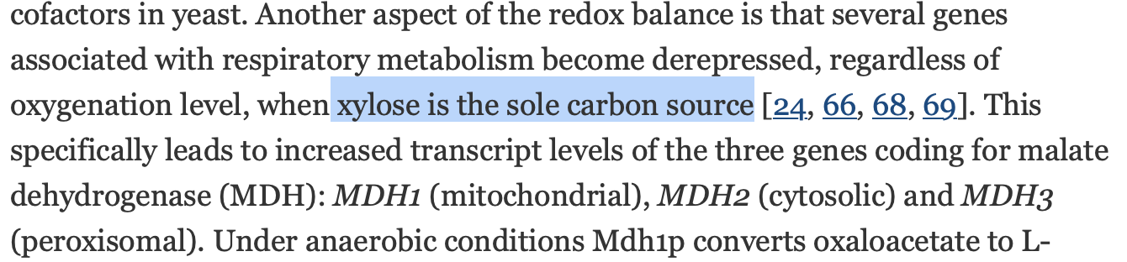
ENERGY SOURCE REGULATION
GO:0006091 generation of precursor metabolites and energy IGD1/PYK2/SHH3/NDE2/MLS1/MDH2/ETR1/PIG2/GLC3/GND2/SOL4/…
Involvement in gluconeogenesis

Slide 14
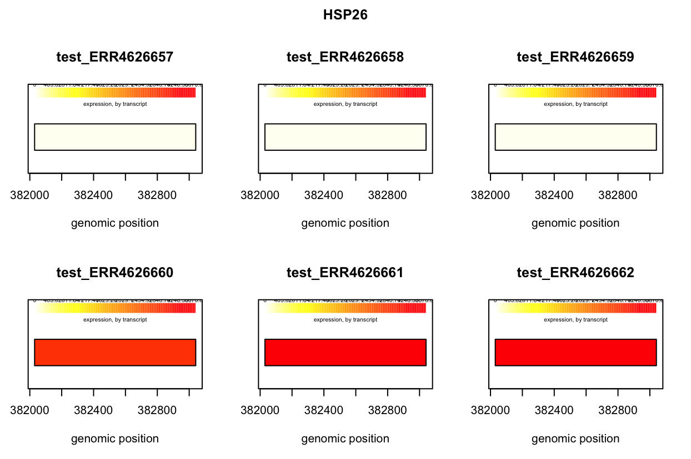
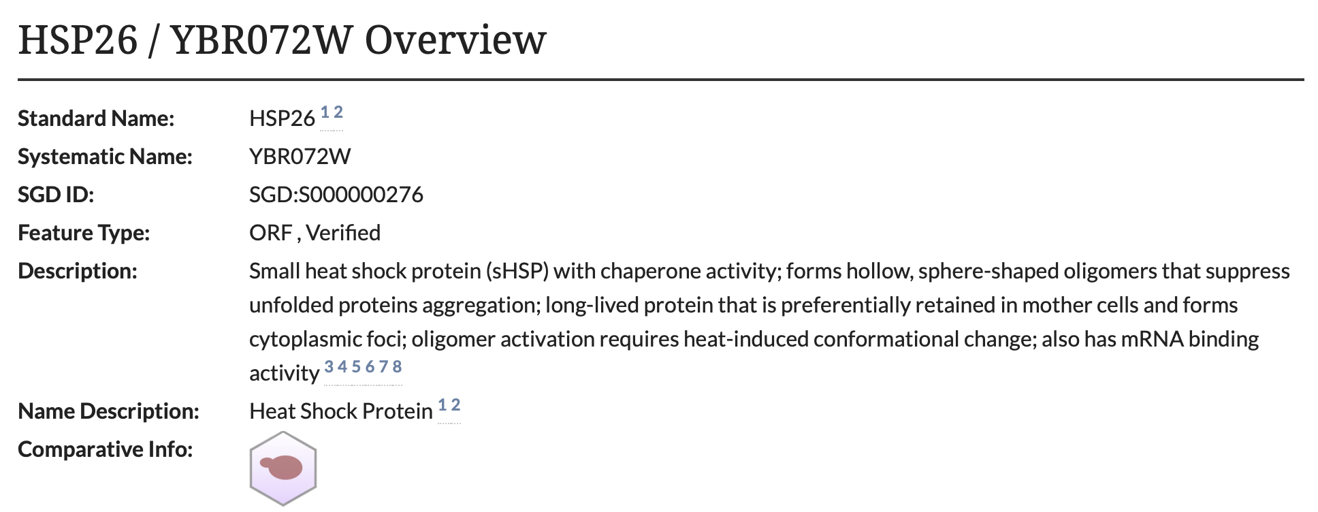
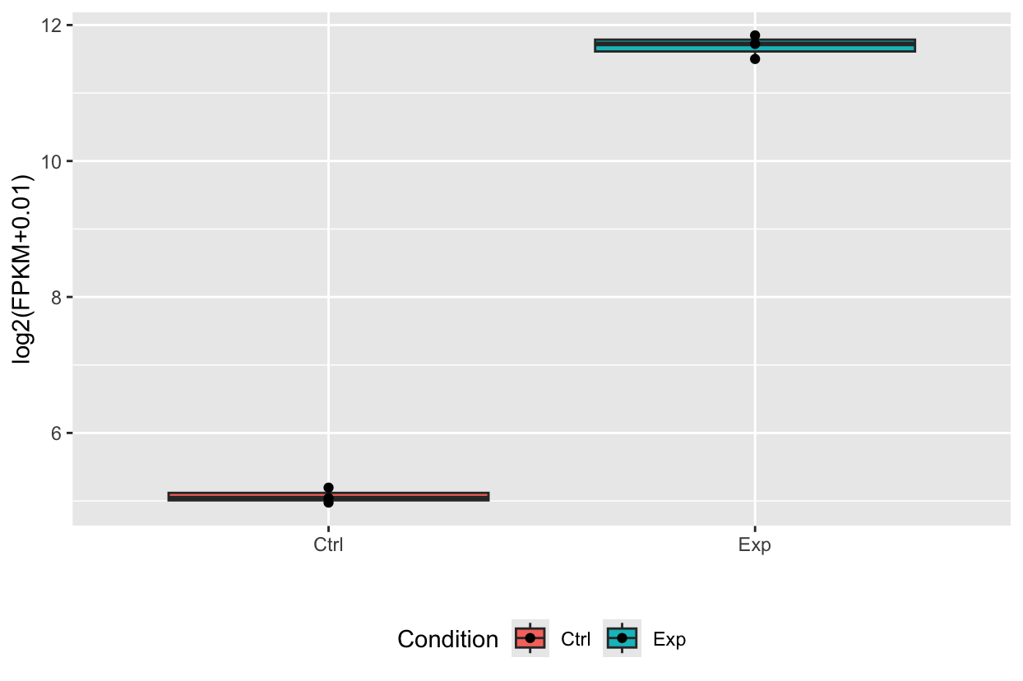
RESPONSE TO OXIDATIVE STRESS
a
GO:0006979 response to oxidative stress
b
Burnie JP, et al. (2006) Fungal heat-shock proteins in human disease. FEMS Microbiol Rev 30(1):53-88 PMID: 16438680
Figure 5. (a) Boxplot and (b) differential expression level of HSP26 between control and experimental dataset

Slide 15
RESULTS
a
b
Figure 4 GO enrichment (Biological Process) of (a)upregulated and (b) downregulated genes based on -1 > log2(foldchange) > 1

Slide 16
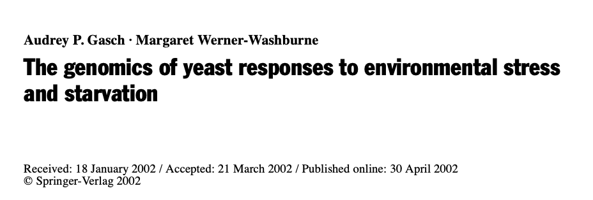
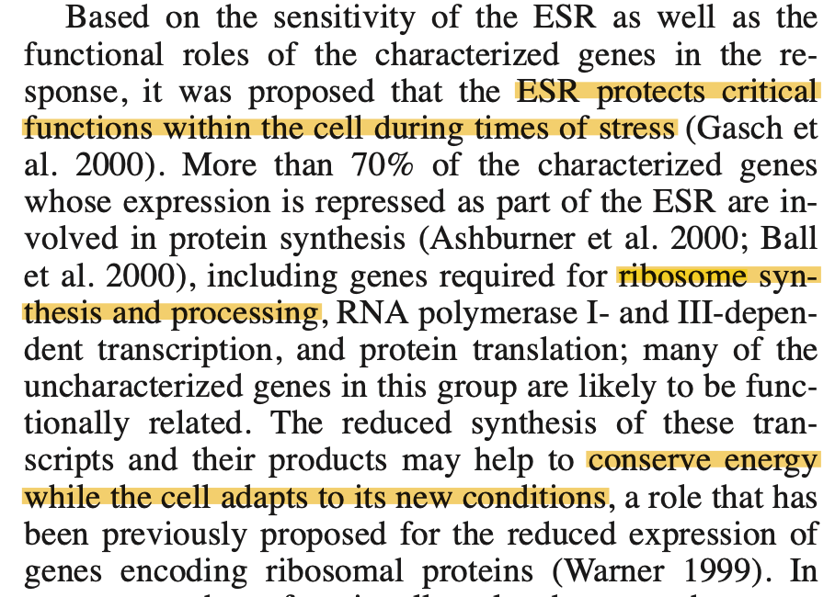
EFFECT OF STARVATION TO RIBOSOMAL BIOGENESIS GENES
GO:0042273 ribosomal large subunit biogenesis
RPL12A/RPL14B/RPL11A/BRX1/CIC1/RPL1A/RPL6B/RPL11B/RPL8A/RLP7/LOC1/RLP24/

Slide 17
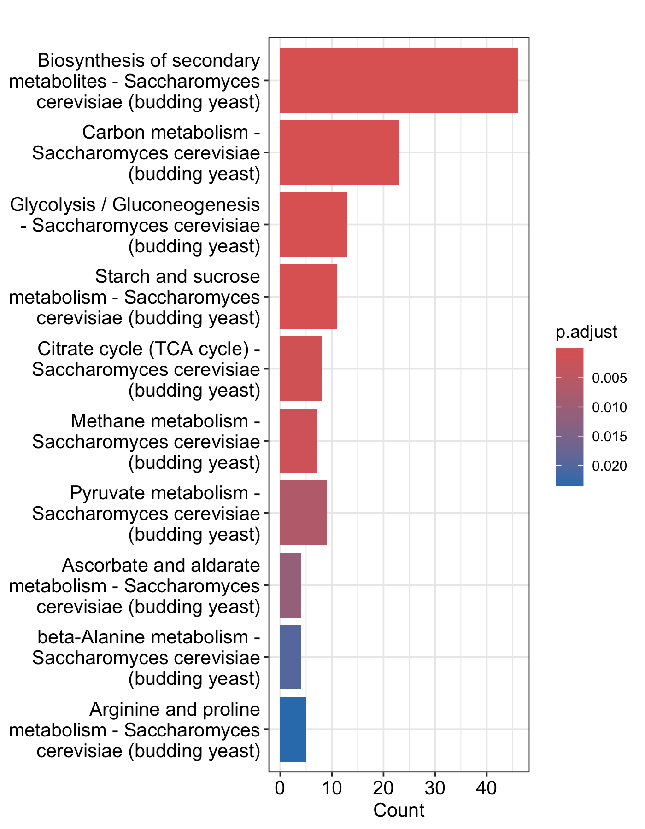
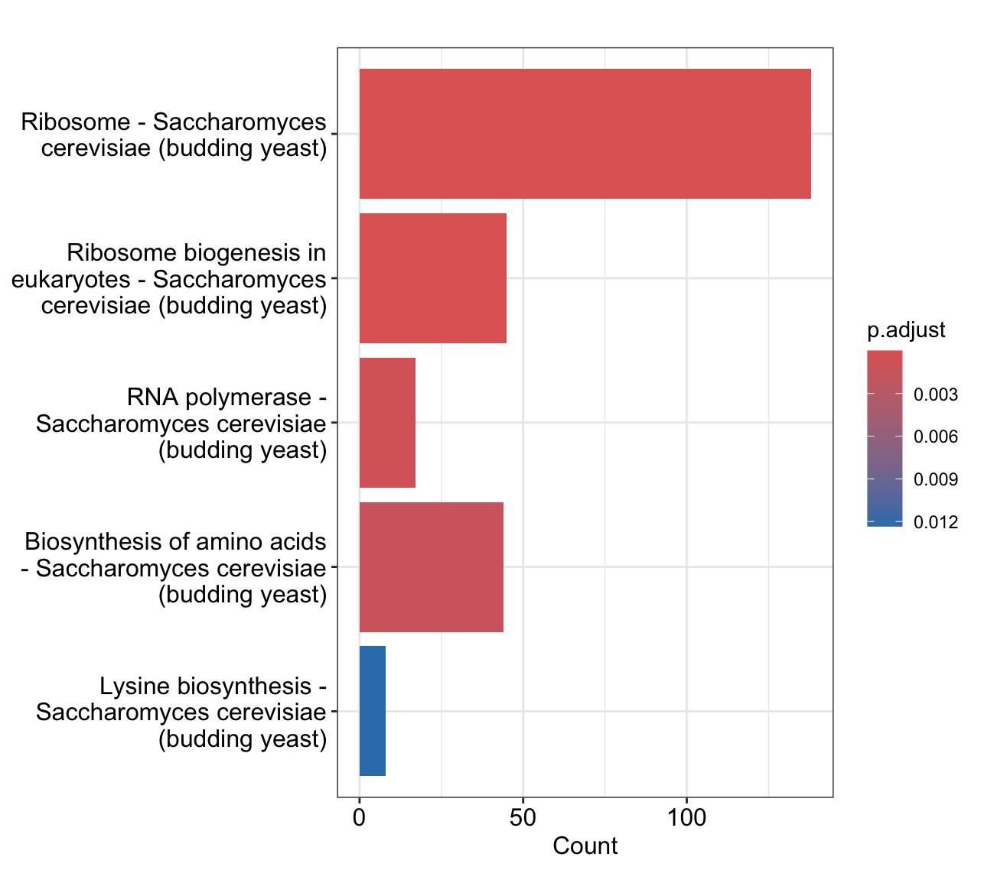
RESULTS
a
b
Figure 6 KEGG pathway analysis of (a)upregulated and (b) downregulated genes based on -1 > log2(foldchange) > 1
Notes:
It looks like purine starvation causes dysregulation of carbon energetic metabolism, where cells are trying to achieve a higher concentration of ATP, by using all available carbon sources and removing glucose repression during metabolism.

Slide 18
CONCLUSION
Between the control and treatment groups,
Upregulated genes are highly enriched in GO terms for generation of precursor metabolites and energy such as IGD1 and MDH2. Meanwhile, downregulated genes are enriched in GO terms for ribosome biogenesis such as RPL12A.
KEGG Pathway analysis shows that many upregulated genes are involved in the biosynthesis of secondary metabolites and carbon metabolism. In contrast, many of the downregulated genes are involved in ribosomal and ribosome biogenesis pathways.
Purine starvation seems to dysregulate carbon energetic metabolism and Ade8 knockout yeast in ade minus (-) condition maintains energy concentration through other carbon metabolism pathways and downregulation of ribosome biogenesis, a high-energy requiring process.

